Slide 1

Game Overview Ver.2014118-01

Slide 2

Game Overview

Slide 3
Game Overview ①
SYSTEM
A 2.5D Side-Scrolling Exploration & Battle Action RPG allowing shifting points-of-view to discover new paths and items not normally visible on a 2D plane to be visible as if it were a 3D plane—a first in the genre of mobile games. Defeat monsters with your “avatar” and “weapon,” and find the key to reach the goal!
CHARACTER
Featuring super-deformed character designs performing dynamic, uplifting action.
With both player avatar and characteristic monster movements resembling something straight out of an anime, the game screen is bursting with action.
BATTLE
Battles against monsters you encounter along the way may play out simply enough, but various hardcore hack&&slash elements are thrown into the mix.
Catch monsters off guard and deal huge damage with combos and special attacks! Experience exhilarating action as you outmaneuver monsters and unleash devastating special attacks!

Slide 4
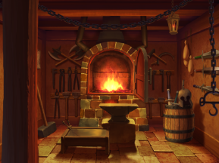
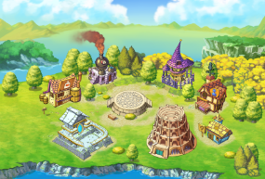
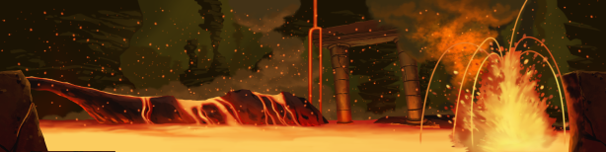
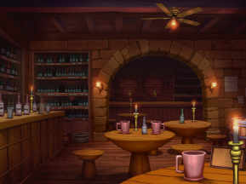

Game Overview②
Game Info
■Title: Gururin Quest
■Release Date: 2015年1月20日(Tentative)
■Supported Devices: iOS/Android
■Supported Platforms: App Store/Google Play
■Price: In-app ourchases
■Target Audience: 20-30 year old males who enjoy dungeon exploration and action rpgs.
World View
Old-school high-fantasy setting with swords, magic, and dragons, but with “multiple worlds” with various motifs such as fairy-tale, steampunk, etc.

Slide 5
Prologue & Characters

Slide 6
Prologue
The one and only world in existence: Scalethrone。
In this world where all living beings co-exist,
a monstrous dragon
suddenly appeared one day.
The dragon used a mysterious power,
breaking the world apart into pieces.
It turned the one world into a series of smaller worlds known as “Vaas.”
As the years passed…
Of all the adventurer guilds in Scalethrone,
thanks to the efforts of the guild in a particular Vaas,
mysterious “labyrinths” were discovered scattered across the land.
Multiple “labyrinths” exist in each Vaas,
and interconnecting each of the Vaas,
is a special labyrinth known as the “Labyrinth of the Ancient Dragon,”
used as a means of passage between the Vaas.
But what was the purpose of this dragon?
Why create these labyrinths? Why connect Vaas through the “Labyrinth of the Ancient Dragon?
It was a mystery no one had yet to uncover.
This is a tale of young adventurers
on their quest to uncover the truth behind the “labyrinths” and the “ancient dragon.”

Slide 7
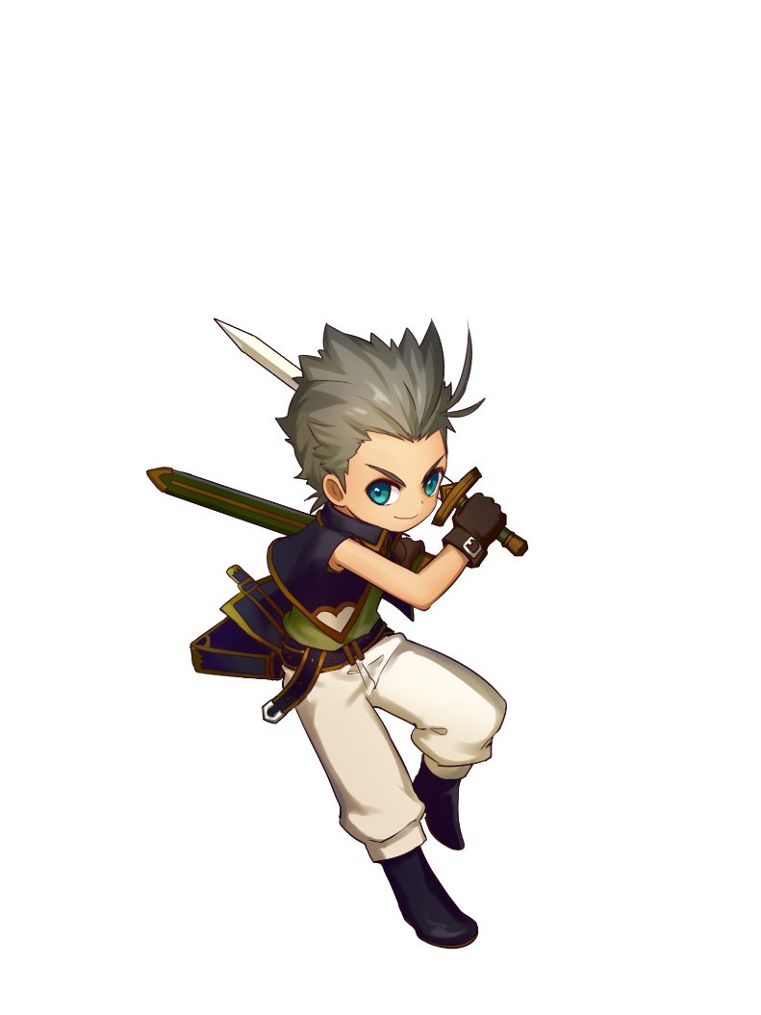


Characters
Protagonist
Navi
Young winged girl small enough to fit in one’s palm.
Hails from the Flower Vaas “Bloom” where fairies live. She wanders into the labyrinth one day and when lost,
she is rescued by Guild Leader Bergant.
She’s now sort of the maid & moodmaker of the Guild.
For the duration of Tru’s parents’ absence,
the guild dispatched her as Tru’s caretaker.
But in actuality, rather than taking care of him,
their relationship is more akin
to that of family or friend.
She wishes to return to her home world someday,
But as she is powerless,
not even being able to clear a labyrinth on her own,
she is under the care of the Guild for now.
Ever since learning of the “Ancient Dragon’s Treasure” from an adventurer at a young age,
this 16-year old has made it his goal to uncover the truth behind it and can’t wait to go an adventure!
His parents are both in the Adventurer’s Guild and have left for what seems to be a long, arduous journey.
In the meanwhile, the Guild is looking after him—making him officially a member of the Guild. But that is a mere formality, he has never
actually embarked on a quest.
With the help of Rutte, he
successfully sneaks into
and clears a labyrinth, and
is recognized for his efforts
as an adventurer.
Swordsman Tru
Fairy Lutte

Slide 8
Game System

Slide 9


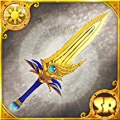
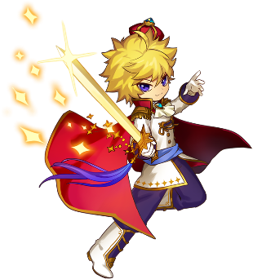
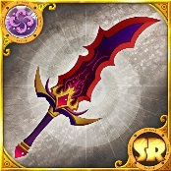
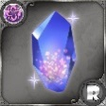
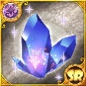
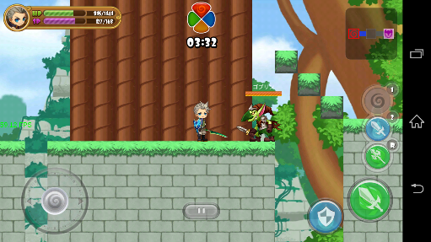
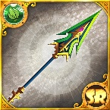
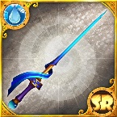
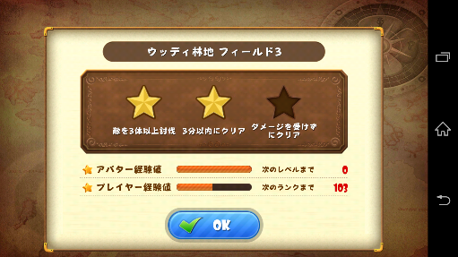

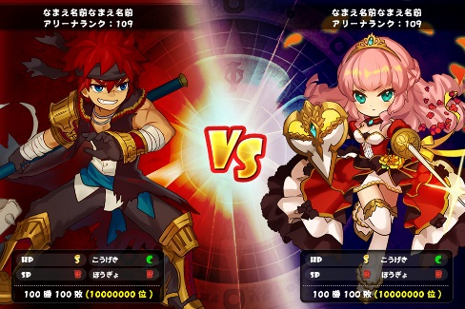

Basic Game Cycle
Quest
Summons (Gacha)
Enhance
Defeat monsters and find keys to clear fields.
Defeat the boss monster to clear the quest.
Obtain gear through summons. Accumulate Avatar Pts that come with certain gear for new avatars!
Enhance or evolve weapons by using gear obtained through quest or summons.
Obtain/Enhance Equipment
Earn Avatar Pts
LEVEL UP!!
Quest Action
Equipment Lv UP!!
Raise stats!
GET Avatar!
To New Area
Arena
Test Your Might
Match up and compete with other players anytime
With specific mission objectives, see who racks up a higher score. Earn bonus points depending on strategy. Victory is decided by total score.
Quest Clear
Compete over various objectives within time limit:
-Monster Time Attack
-Item Collection Time Attack
1v1 Score Battle

Slide 10
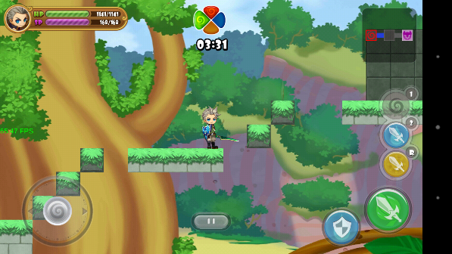


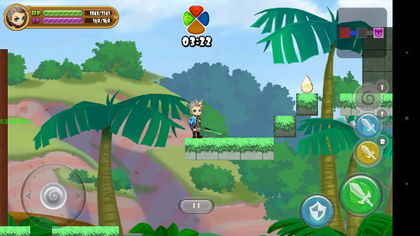
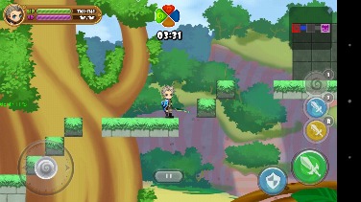


Game System
Quest
New exploration & battle action -- change POV by flicking the screen to discovering new routes and items!
Single-player action quests make up the core of the game.
These 3D-dungeons viewed from a 2.5D perspective with the camera changeable per 90 degrees.
Proceed along the fields by defeating monsters in your way, and changing the camera by flicking the screen to find keys.
The player improves by completing quests, while the avatar improves by defeating monsters. In addition, finding the various across treasure chests and carrying them back can yield rare items.
Reach places you couldn’t get
to before!
Flick
Rotate screen to reach the goal!
ぐるりんっ!!

Slide 11
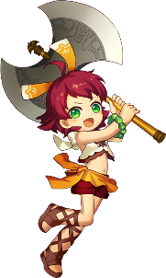
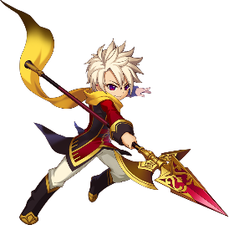

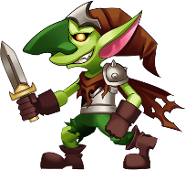






Action①
Battle Action
Battle action rules for defeating the onslaught of monsters.
Simple back-and-forth duel, yet highly strategic battle system.
Systemt
ATK/DEF
Affinity
Skill
When coming across monsters, battle with weapon and shield. Reading their movements
is all part of the strategy.
5 elements and a weapon triangle. The player switches between various weapons to take advantage of the monster’s weakness.
Use Skill Pts earned in battle unleash fancy active skills, and bestow passive skill on avatar simply by equipping gear.
Bestowing effects such as cooldown reduction or stat boosts
Back-and-forth duel against monster.
Strategic value when battling monsters

Slide 12
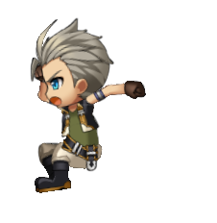
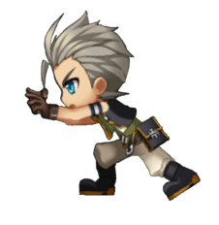


Action②
Exploration
3 characteristic actions.
Allowing for more greater depth in dungeon exploration.
System
Screen Rotation
Movement Rules
Gimmicks
Flick screen to left/right
to rotate camera by 90 degrees, allowing for full 3D exploration of platforms normally deep in the background.
Climb, fall, jump: 3 movement types with a shared set of rules.
Puzzle objects are placed on the field. Touch and move them around for various actions. Helpful with exploration in both
2D and 3D terms.
ぐるりんっ!!

Slide 13
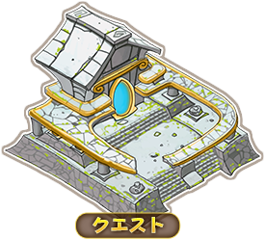
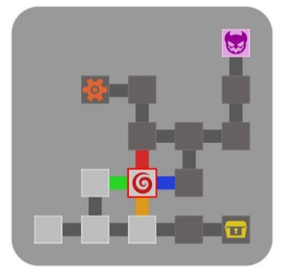
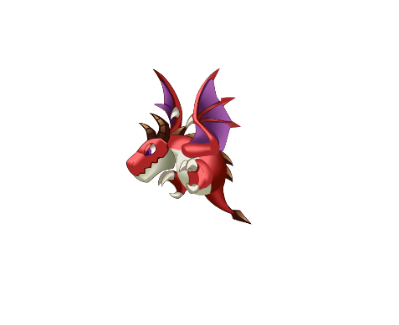

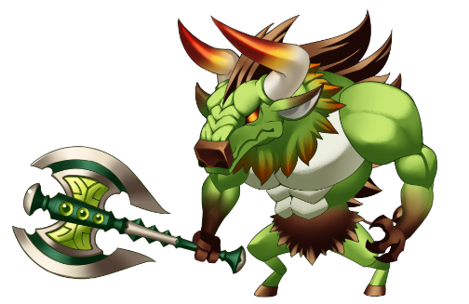
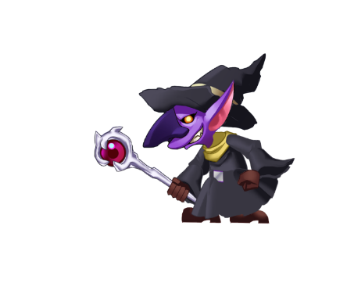
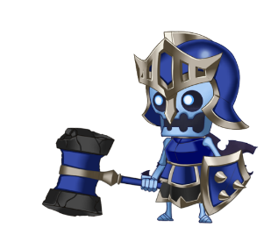


Game System
Quest Progression
Exploration & battle action to reach the area end boss within time-limit while clearing objectives for each individual block.
Exploration & Battle in Quests
to Defeat Boss w/ Time Limit
【Basic Progression】
Clear each block to reach the boss.
Defeat the boss to unlock next quest.
【Clear Objective 1】
Annihilate all enemies!
【 Clear Objective 3】
Defeat boss & cohorts
【 Clear Objective 2】
Search for keys

Slide 14


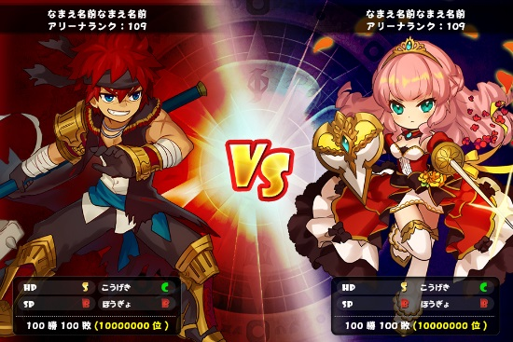


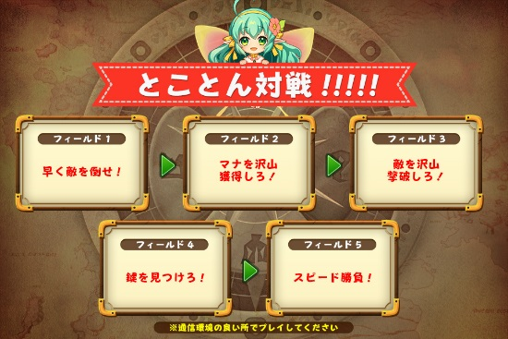
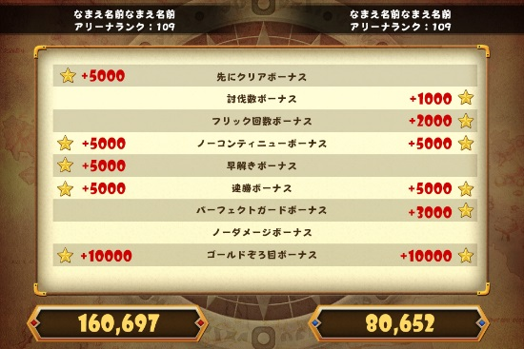
Game System
Arena
1v1 Battle Mode for players to casually compete with each other.
Test the skills and strategies you’ve acquired in Quest Mode
Players engage in a score attack under various conditions in 2.5D dungeons.
Matching to a player of similar skill level is done in real-time.
Monster Time Attack(defeat xx within xx:xx, etc.) is the base logic
Blocks testing time passed until reaching goal, or items collected within time limit, etc. A combination of all these block challenges make up the entire field score challenge. Bonus pts are awarded depending on how it was cleared, and added to total score. Victory leads to greater rewards and ranking.
1vs1 Competition!! Score Attack!!
【Characteristic 1】
Determine the order you want to clear the field.
【Characteristic 2】
Choose fields of different sizes depending on play style.
【Characteristic 3】
Earn bonus pts based on performance.

Slide 15


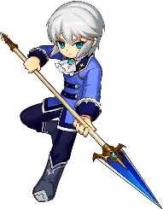



Leveling up
Leveling up
Acquire and master more and more avatars to make exploration a breeze! Obtaining various gears and using them strategically depending on situation is key to advancing.
３ ways to level up
Player
Avatar
Gear
Defeat monsters for Avatar EXP. Lvling up means increased stats.
Max one out for a permanent bonus that carries that carries over to any avatar.
Obtain gears through “Quests” and “Summon,” and level up by “Enhancing” with material gear. Rarity determines potency. Affects ATK/DEF and the Avatar’s physical appearance.
Levels up by Exp earned when clearing “Quests.”
Affects stamina for playing quests, and number of slots for gear, friends, and monsters.
Main Stats
-Stamina
-Life
-Inventory limits
Maxing out avatars for that permanent boost is key.
5 Equipment Slots:
・Weaponx2
・Shield
・Accessory
・Friend’s Weapon
Most Basic Game Stats
Stats for Action Part
Strengthens Avatar

Slide 16

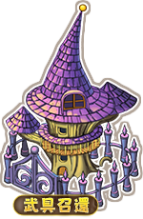

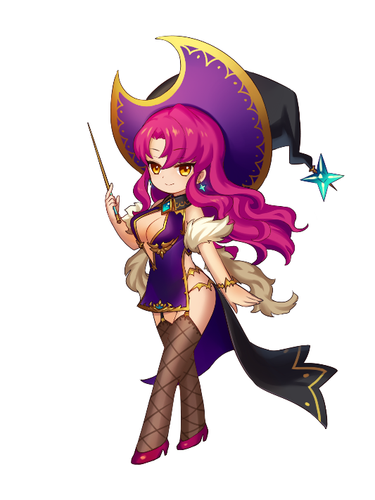


Other
Facilities
From Enhancement and Summons essential for player growth, to Shop and Friend facilities to assist us in adventure.
Facilities Overview
Enhance
Summons
Facility to level up gear. There’s the basic “Enhance”, reach Max Lv to “Raise Lv Cap,” and lastly, “Evolution” into another weapon.
Facility to “Summon” random gear. “Friendship Summons” is free, while “Rare Summons” requires gems.
Acquiring certain gear here can mean access to particular avatars.
Shop
Friend
Facility to increase stamina needed for gameplay, life recovery, and gear/friend slots.
Can also purchase “Gems” needed for rare Summons here.
In general, friend requests can be made when borrowing weapons and both players consent. Two types here: Online friends, and Facebook (SNS) friends.

